Slide 1
REVERSO
NEW WAY
TO
SHOP ONLINE

Slide 2
REVERSO LOGIN
Sign In
Register

Slide 3
If Sign In: If Register:
Username or Mob no.
Password
Username or Mob no.
Password
Retype Password
Email
Sign In
Register

Slide 4

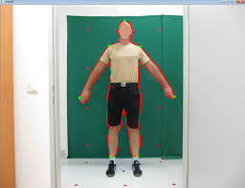
360 Camera Detection
Face Detection
Body Detection
Try To fit You Face Inside Square
Try to fit your body inside this figure

Slide 5


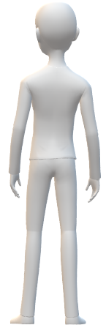
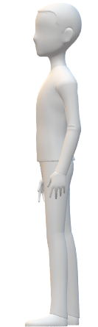
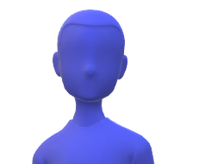

SCANNER FEATURE
FACE SCANNING

Slide 6
Approx A.I Analyzer Result
Upper Body Measures
Lower Body Measures
● Leg Length
20
Chest
Arm Length
Waist
12
34
23
LETS GET STARTED !
NOTE : These Measures will be saved in your database for future purposes and can be changed by customer/user choice afterwards.

Slide 7
TRY CLOTHES VIRTUALLY
DESIGN NEW
CLOTHES

Slide 8
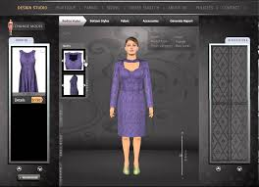
IF TRY CLOTHES VIRTUALLY :
1st window
2nd window
Reverso Virtual Trial Room
Reverso V.T Slots
Upload A Picture
BROWSE

Slide 9

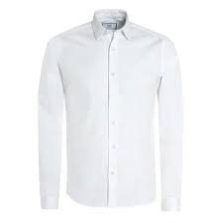
IF DESIGN NEW CLOTHES:
Select Your Wear
Select your Upper Wear
Upper Wear
Bottom Wear
T Shirt
Shirt

Slide 10
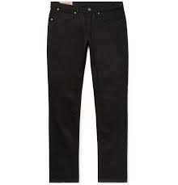

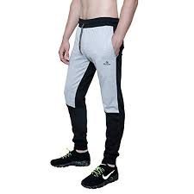
IF DESIGN NEW CLOTHES:
Select Your Wear
Select Your Bottom Wear
Upper Wear
Bottom Wear
Jeans
Shorts
Pajamas

Slide 11


Lets Assume you want to Design a T-Shirt
IF TRY VIRTUALLY:
Reverso Pro Designing Room
Looking Great!
Text
Color
Designs
Try Virtually
BUY NOW

Slide 12
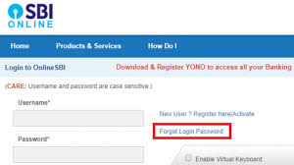
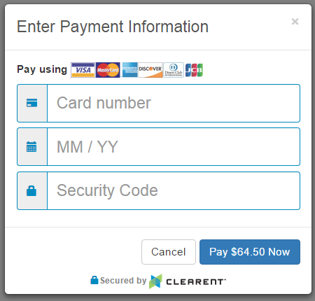
Payment Procedures
CARD
NET BANKING

Slide 13
Reverso Team
Dear Customer, Your Payment has been received and within a week for sure you will receive your parcel.
For More Details Contact to 8076333489/9717403142.
THANK YOU FOR SHOPPING.
HAVE A GREAT DAY.

Slide 14
Introduction
The primary aim of this app is to create a virtual trial room for the online consumers this app is mainly for all who mostly buy their things online and feels annoying to visit shopping mall and also for them who shops most of the things online. It basically focuses on the clothes or we can say outfit and accessories like shades or sunglasses and Scarfs. Just think for once before buying clothes from online if you can wear and see the clothes how amazing it would be. Just think for once you liked a good outfit on online shopping and you want to buy that outfit but you are confuse whether it would suit you or not. This app will solve that problem in minutes it will create a virtual trial room for you and it will provide you an Analyze how good or bad are you looking at your outfit Which you want to buy and you can also share your virtual trial room images to your near and dear ones to take the view point of them.

Slide 15
Agile Manifesto
Individuals and interactions over Processes and Tools : Interactions with developers or client department for easy interface between user and application i.e making amateur tools that any age of person can use moderately.
Customer collaboration over contract negotiation : As we will collaborate with our customers and listen to their requirements and will bring update in our project .
Working software over Comprehensive Documentation: We can collaborate accessing or surfing our application. Collaborating with customer not only give us support for better application but along we get innovative ideas that we can implement in application.
Responding to change Over Following a Plan : As we get reviews from user and problems related to application or product, but as ability to making changes decrease & cost increases. By through reviews we can our update application to fulfill customer basic needs and Our team will approach planning, working & giving priorities to feedback/ reviews and giving them a quick change for nil disturbance.

Slide 16
List Of Diagrams
The List of diagrams Include the following :
Entity Relationship Diagram (ERDs).
Data Flow Diagrams(DFDs).
Level 0
Level 1
Level2
State Chart or State Diagram.
Sequence Diagram.
Class Diagram.
Pert Chart.

Slide 17
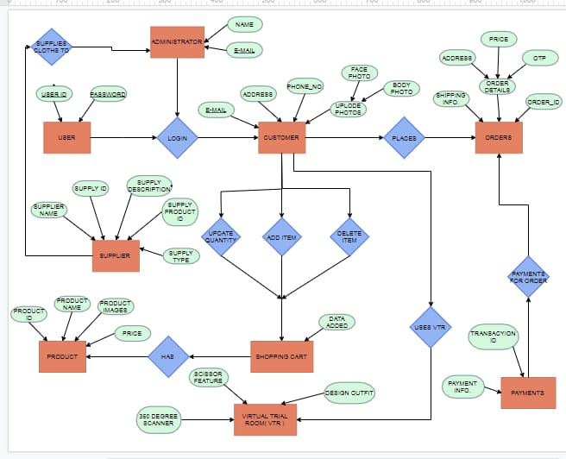
Entity Relationship Diagram

Slide 18
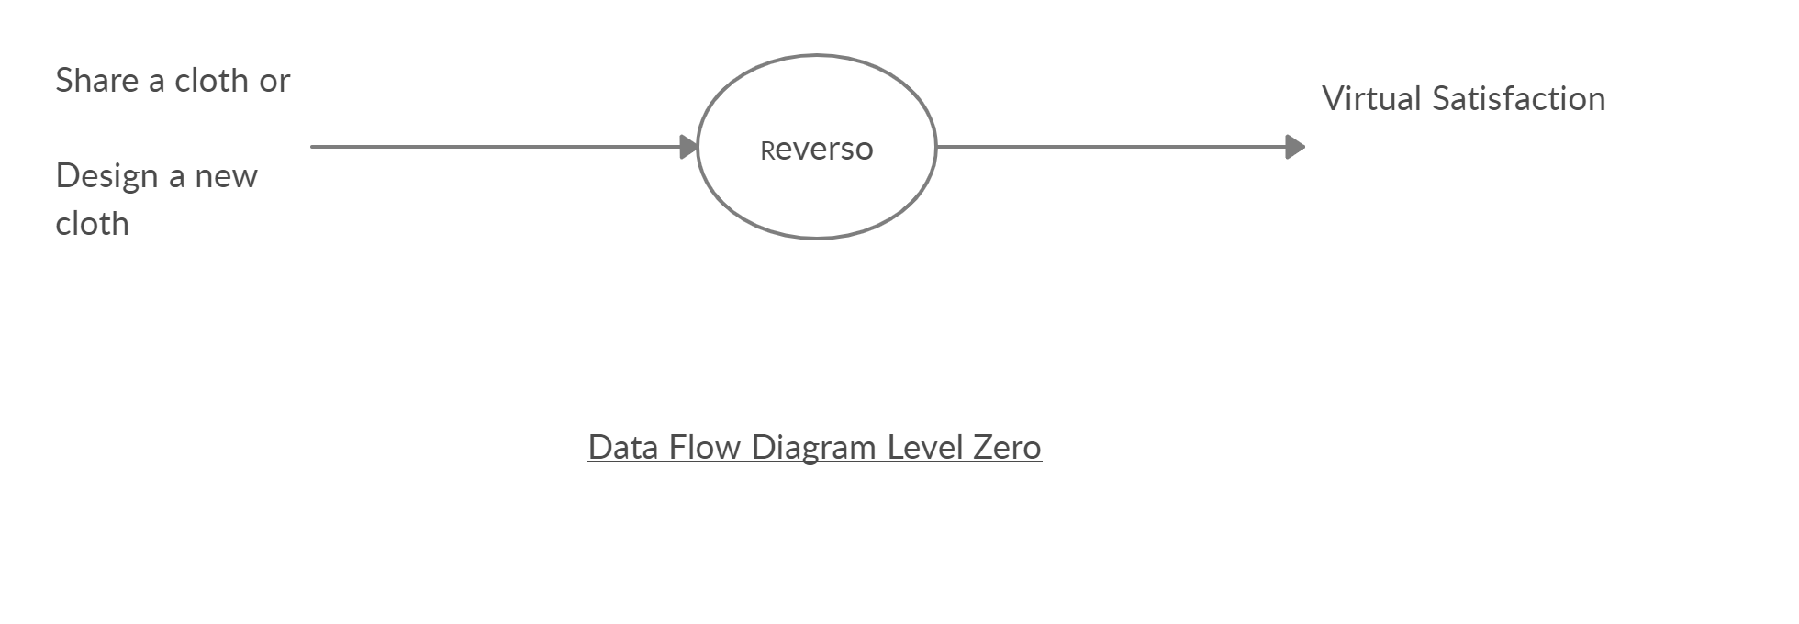
DFD (Level 0)

Slide 19
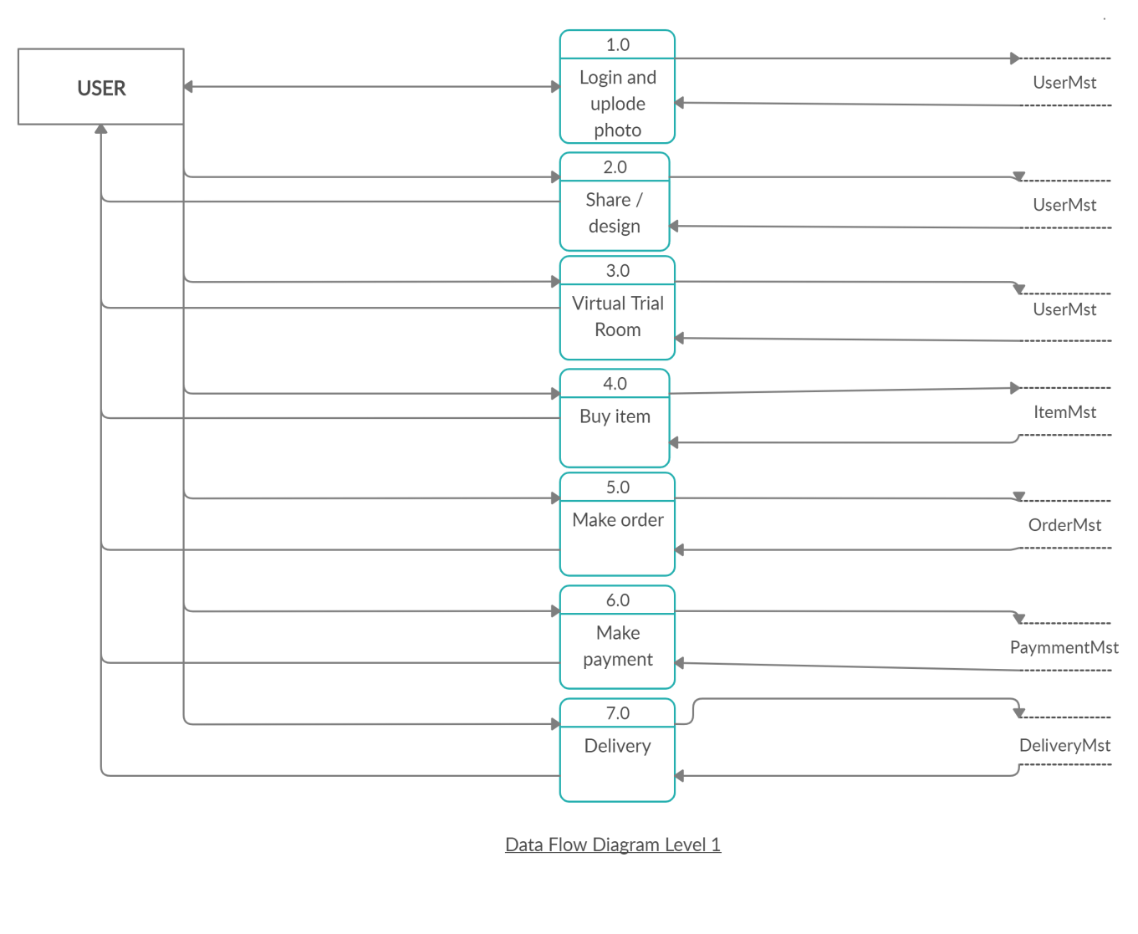
DFD(Level 1)

Slide 20
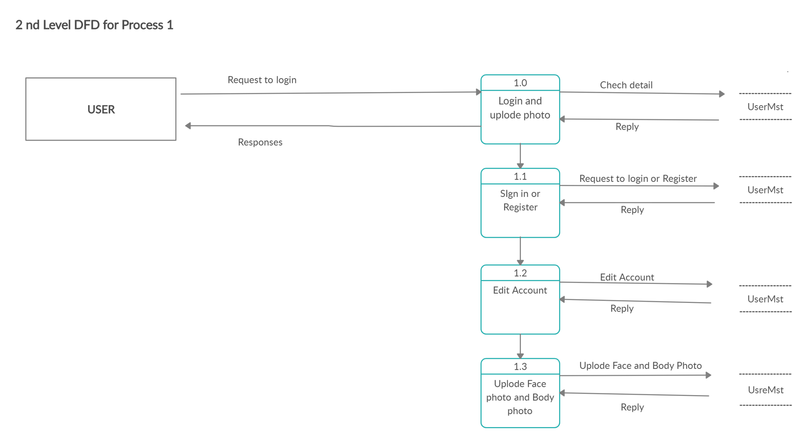
DFD Level 2 (Process 1)

Slide 21
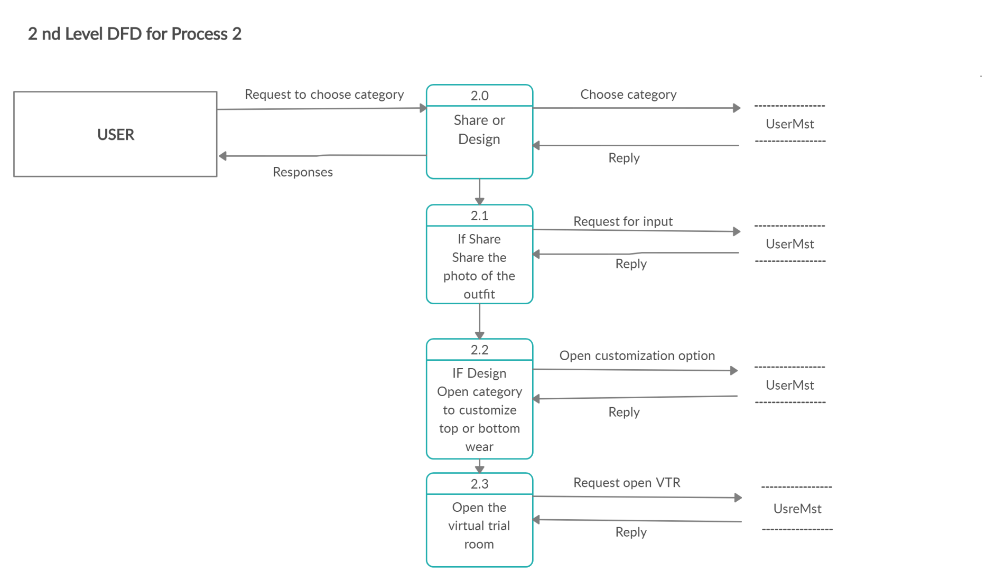
DFD Level 2 (Process 2)

Slide 22
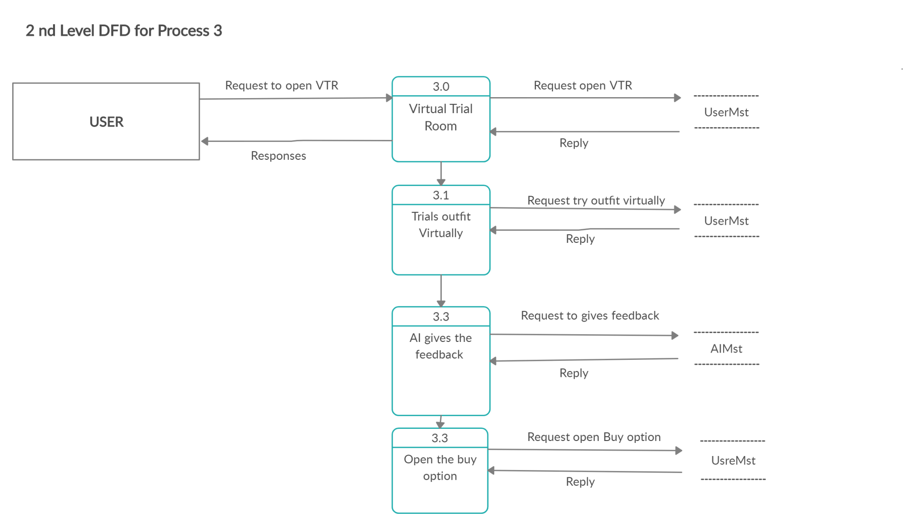
DFD Level 2 (Process 3)

Slide 23
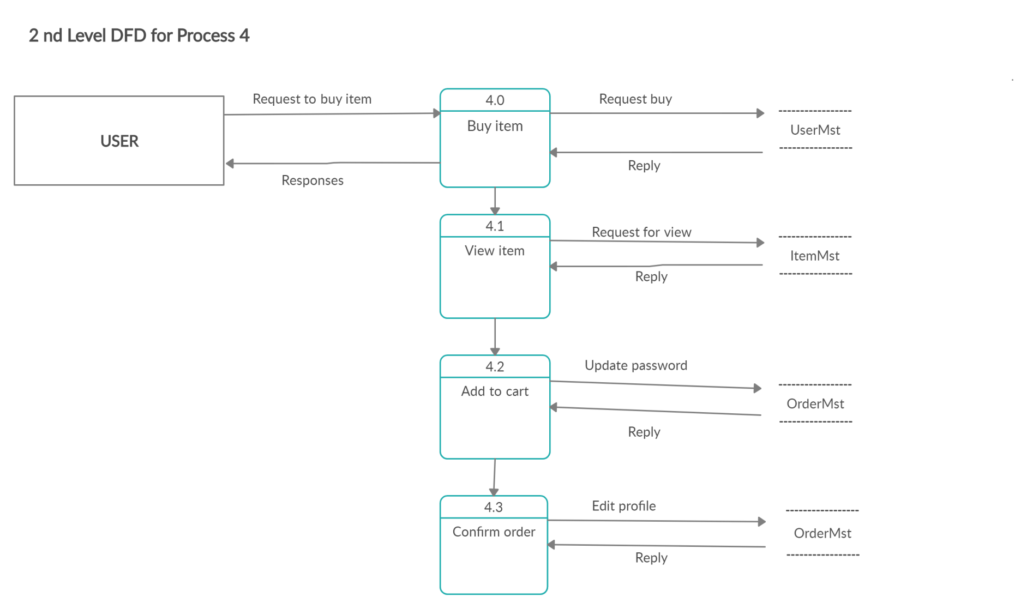
DFD Level 2 (Process 4)

Slide 24
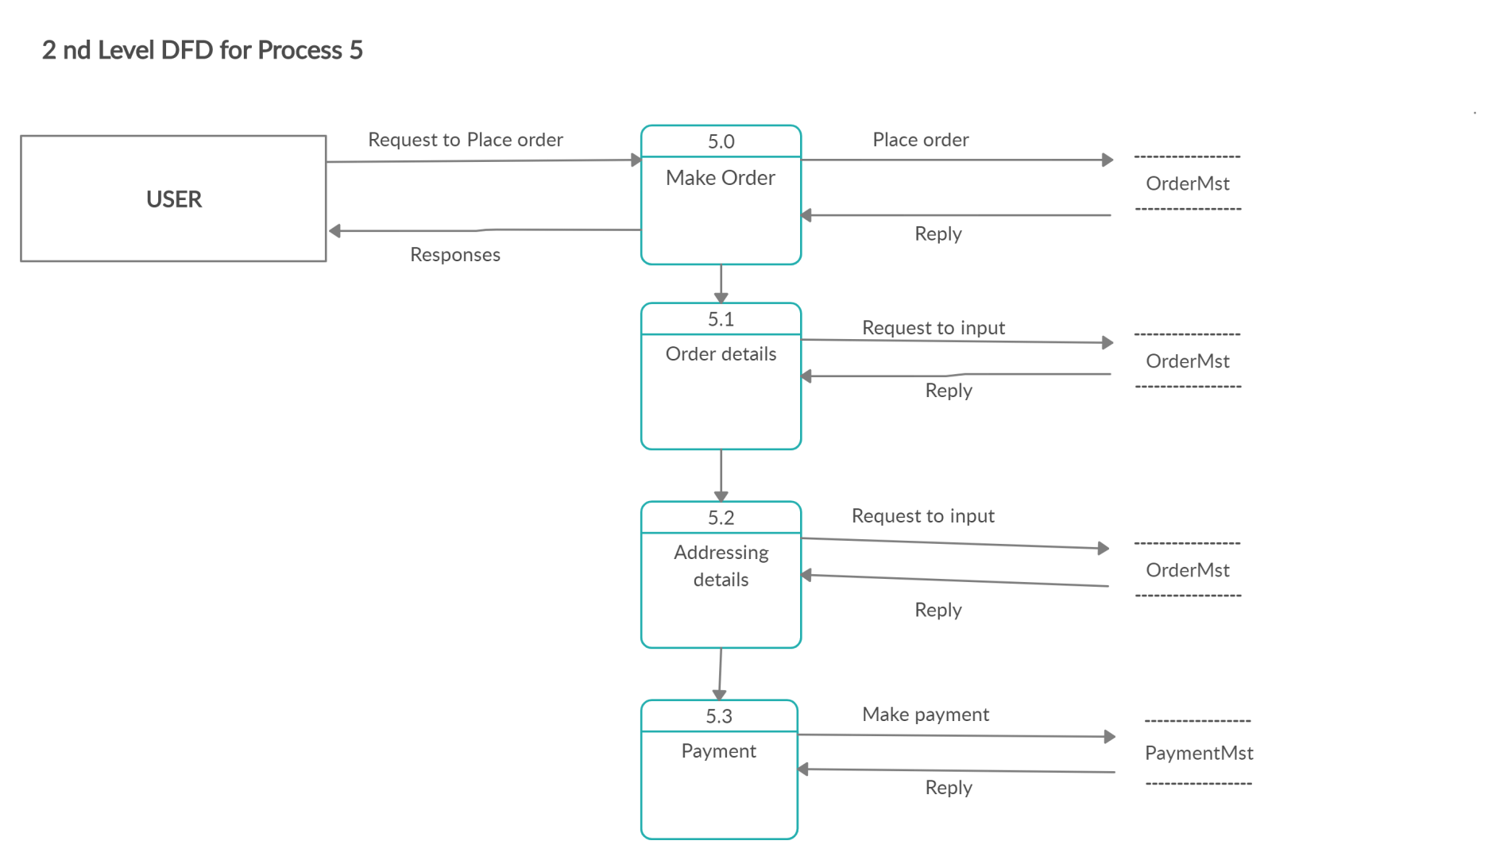
DFD Level 2 (Process 5)

Slide 25
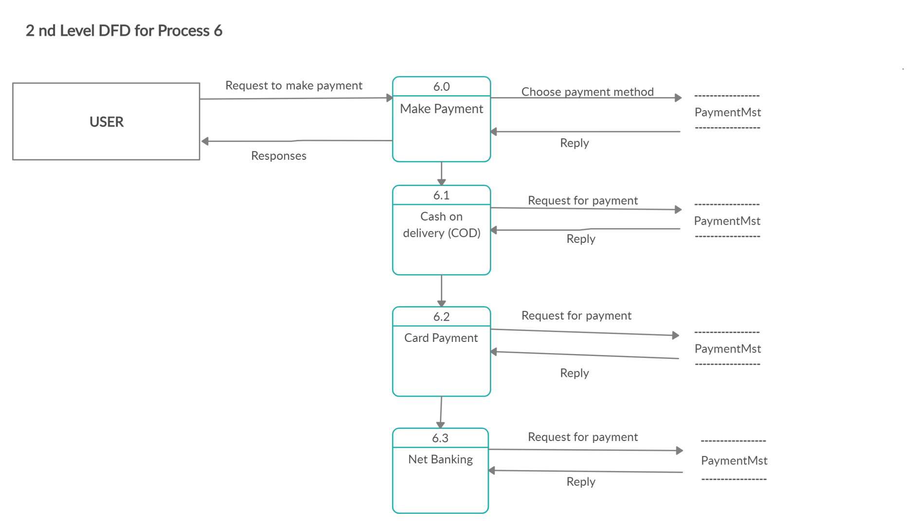
DFD Level 2 (Process 6)

Slide 26

DFD Level 2 (Process 7)

Slide 27
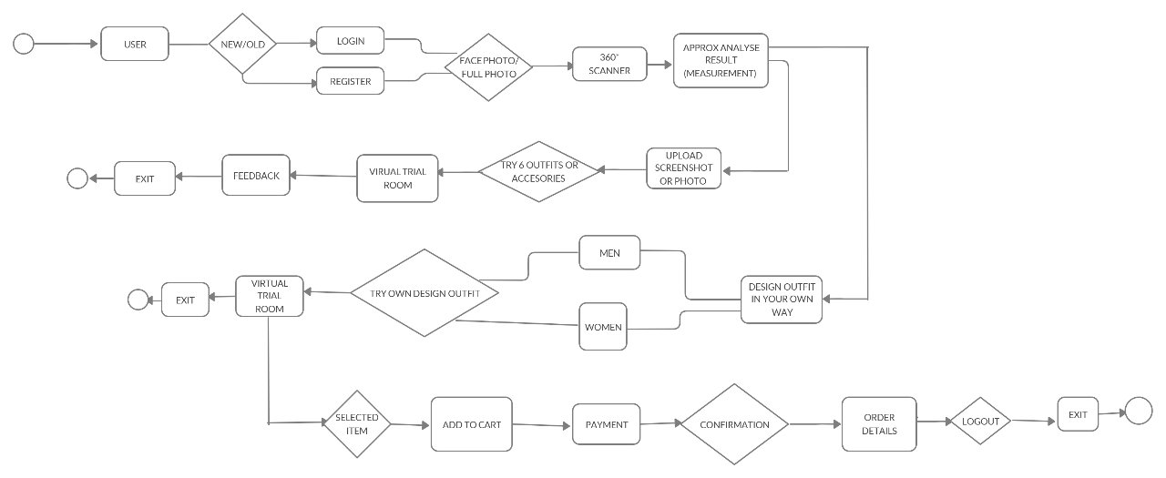
State Chart or State Diagram

Slide 28
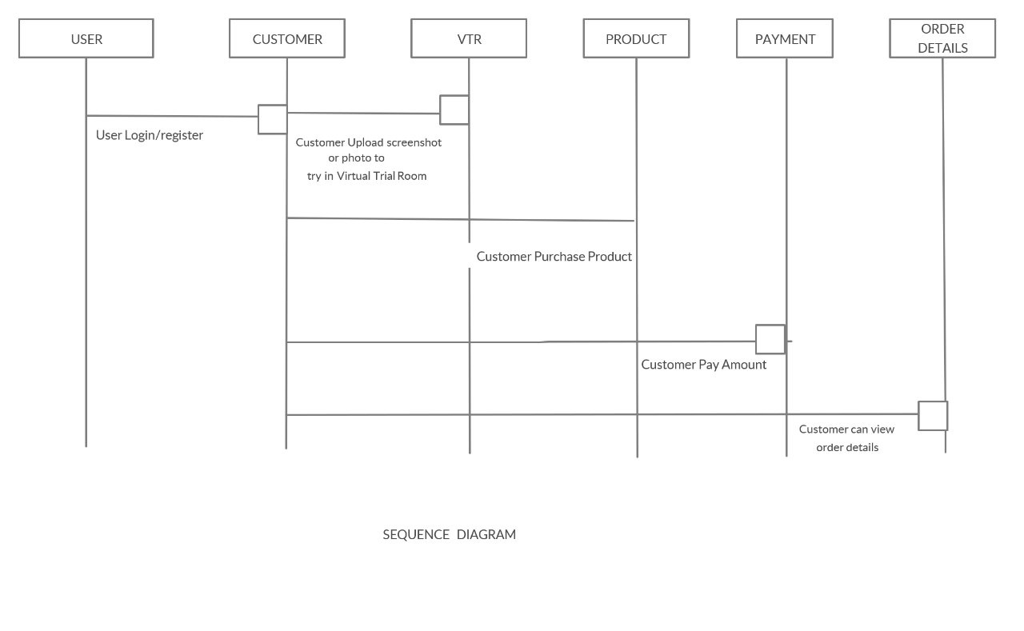
Sequence Diagram

Slide 29
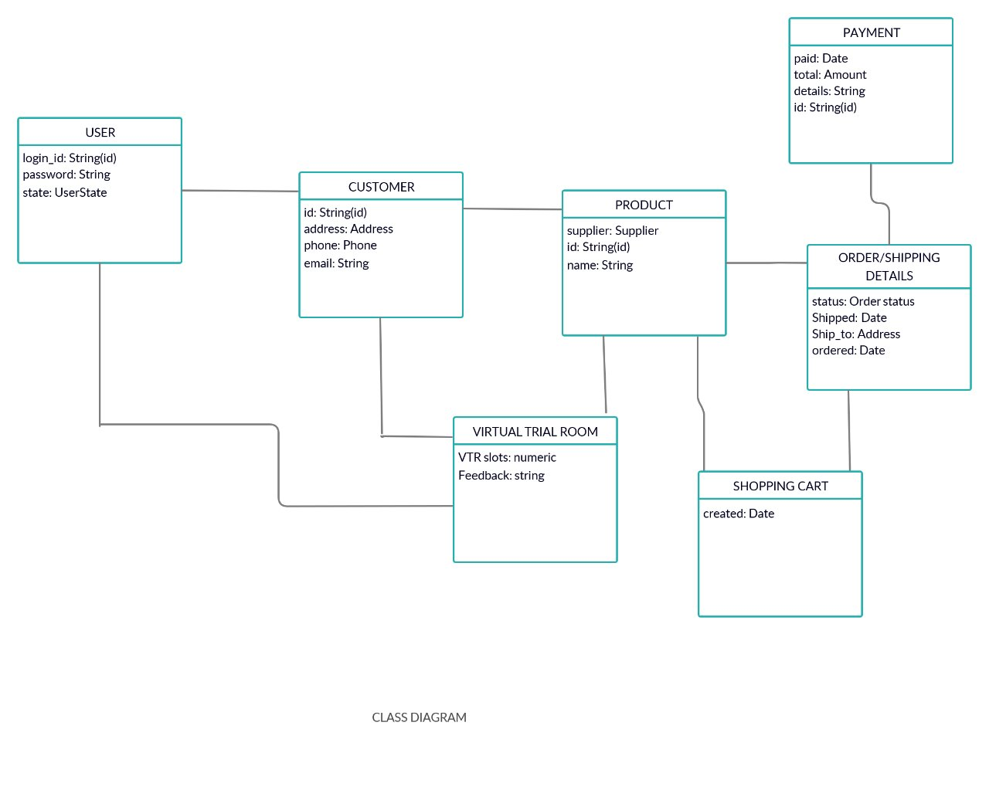
Class Diagram

Slide 30
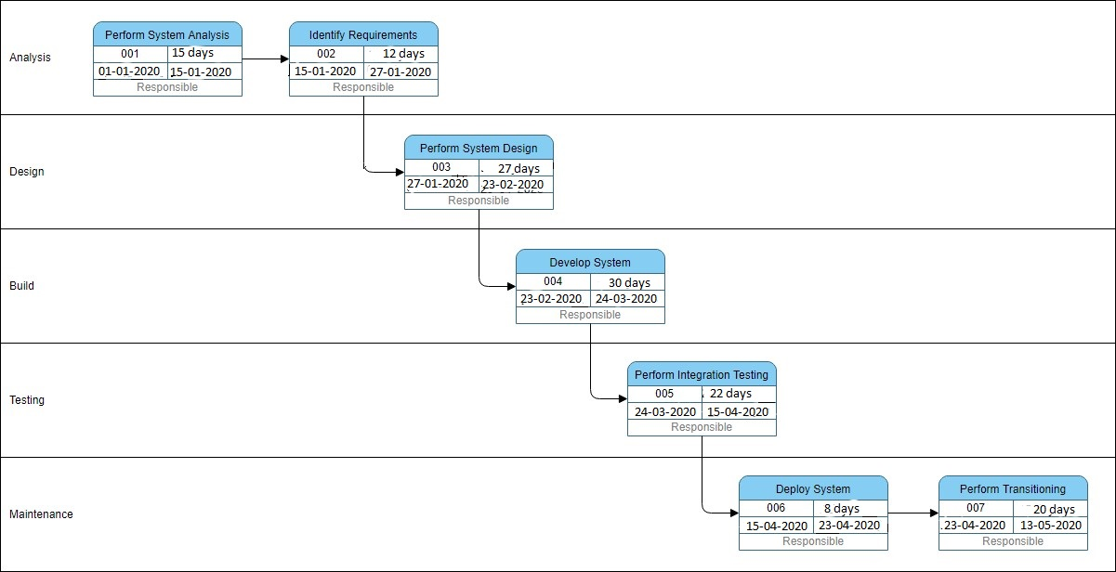
Pert Chart

Slide 31
What is Scrum Methodology ?
Scrum is an Agile process framework for managing complex knowledge work, with an initial emphasis on software development, although it has been used in other fields and is slowly starting to be explored for other complex work, research and advanced technologies. It is designed for teams of ten or fewer members, who break their work into goals that can be completed within timeboxed iterations, called Sprints. No longer than one month and most commonly two weeks, then track progress and re-plan in 15-minute time-boxed daily meetings, called daily scrums.

Slide 32
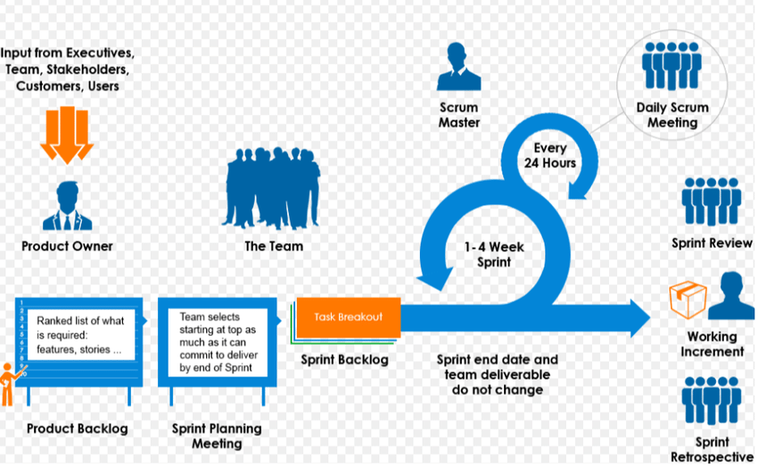
SCRUM FRAMEWORK

Slide 33
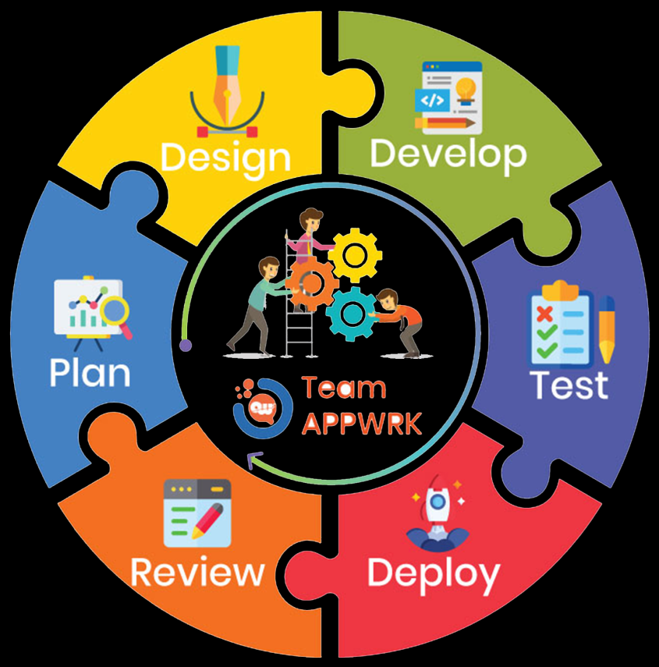
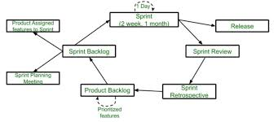
SCRUM MODEL

Slide 34
Steps for Scrum Methodology
1.Create a Product Backlog: Product backlog is a list of absolutely all product requirements sorted by their priorities. A backlog exists and evolves throughout the whole life of the product, which serves as a guide for the team
2. Specify and estimate the product backlog: Team members have to look at each task and determine:
Whether it is realistic to achieve at all.
Is there enough information to complete the task?
Are the description and requirements understandable enough to be evaluated?
Is there general understanding of what kinds of standards and criteria it has to meet in order to be completed?
Does it add real value to the final product?
3. Plan your sprint
4. Make workflow transparent:It is necessary to give people freedom, respect and the right to do their own thing. The heads of organizations where everything is kept secret do not want ordinary employees, leading specialists, even managers close to the top of the hierarchy — To know what is happening now, what has already been done and in what time frame.
5. Daily meeting or daily Scrum.
6. Demo to Customer.
7. Retrospective meeting: Looking back on past meeting and improve bugs or Update Features .
8. Start the next sprint immediately: The most important thing in this methodology is customer orientation. The customer must get what he wants, on time and with minimal effort.

Slide 35
What is Sprint?
Sprint is a repeatable fixed time-box during which a "Done" product of the highest possible value is created. Sprint lies at the core of the Sprint agile methodology and can be thought of as an event which wraps all other Scrum events like Daily Scrums, Scrum Review and Sprint Retrospective. Like all of scrum events, Sprint also has a maximum duration. Usually, a Sprint lasts for one month or less.
Usually, daily meetings are held to discuss the progress of the project undertaken and any difficulty faced by any team member of the team while implementing the project. The outcome of the sprint is a deliverable, albeit with some increments. The scrum is used for projects like Web Technology or development of a product for the new market, i.e. the product with lots of requirement or fast-changing requirement.

Slide 36
Sprints of Reverso
The Reverso is divided into 4 sprint parts because as we are 4 members in group it would be fair for everyone.
Sprint 1: Registration and Upload Photos.
Sprint 2: Share Or Design Cloth.
Sprint 3: Virtual Trial Room.
Sprint 4: Payment and Delivery.

Slide 37
Thank You

